Slide 1
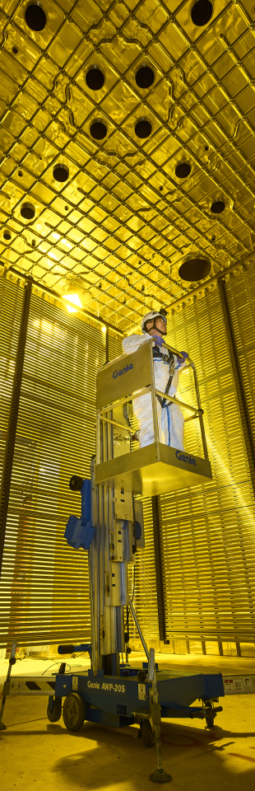

ON a common simulation framework for tms
Presents: Federico Battisti

Slide 2
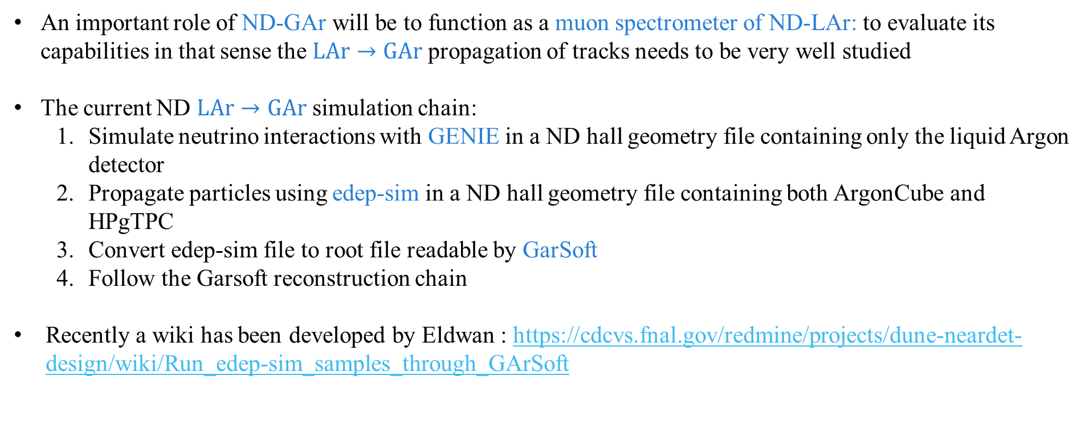
Lar to Gar sample: motivation and current procedure
An important role of ND-GAr will be to function as a muon spectrometer of ND-LAr: to evaluate its capabilities in that sense the $LAr→GAr$ propagation of tracks needs to be very well studied
The current ND $LAr→GAr$ simulation chain:
Simulate neutrino interactions with GENIE in a ND hall geometry file containing only the liquid Argon detector
Propagate particles using edep-sim in a ND hall geometry file containing both ArgonCube and HPgTPC
Convert edep-sim file to root file readable by GarSoft
Follow the Garsoft reconstruction chain
Recently a wiki has been developed by Eldwan : https://cdcvs.fnal.gov/redmine/projects/dune-neardet-design/wiki/Run_edep-sim_samples_through_GArSoft

Slide 3
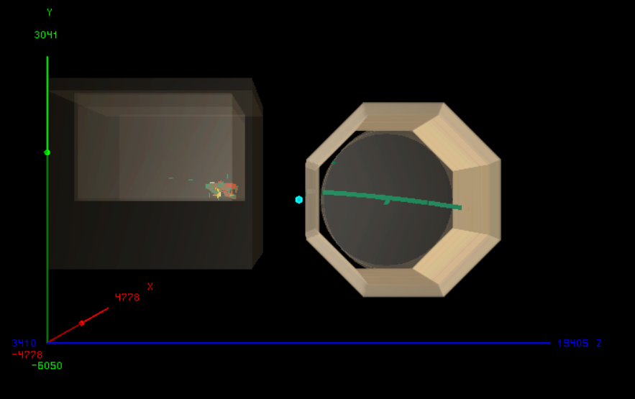
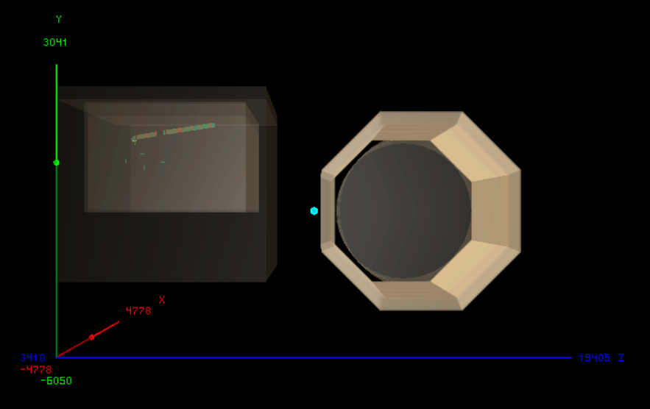
Lar to gar sample: an example
Two examples of $ν_{μ}\left(CC\right)$ interactions in ArgonCube one with a passing muon reaching NDGAr, the other without (both made with edep-disp)
PASSING MUON
NON-PASSING MUON

Slide 4
Lar to gar sample: improvements
Strong need for large LAr samples already propagated in edep-sim to test the chain
L2G: interface that takes outgoing LAr particles and feeds them to edep-sim with any TMS detector could speed up the sample production (Currently starting to work on it with Eldwan towards TMS meeting)
Constant B-field currently being used (Custom B-field is already implemented in edep-sim/GArSoft )
Need to improve the track reconstruction and fitting and to integrate with NDLAr
Simulated LAr sample
L2G
SSRI
ND-GAr lite
ND-GAr
https://indico.fnal.gov/event/44562/contributions/200915/attachments/136745/170170/DUNE_ND_Meeting_28.10.20.pdf

Slide 5
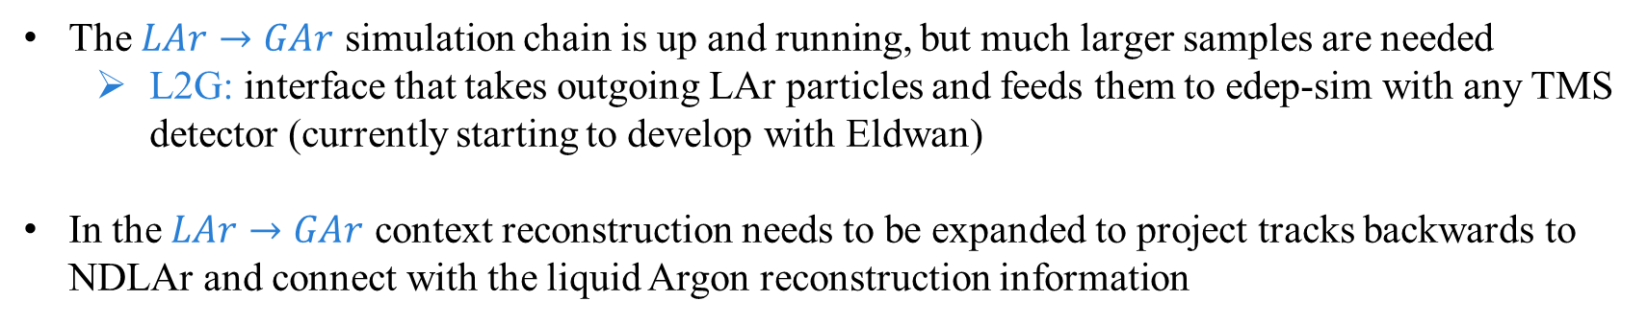
SUMMARY AND FUTURE STEPS
The $LAr→GAr$ simulation chain is up and running, but much larger samples are needed
L2G: interface that takes outgoing LAr particles and feeds them to edep-sim with any TMS detector (currently starting to develop with Eldwan)
In the $LAr→GAr$ context reconstruction needs to be expanded to project tracks backwards to NDLAr and connect with the liquid Argon reconstruction information

